Slide 1

Key Stage 2 SATS
Mr Forwood and Mrs Axtell
30th April 2026

Slide 2
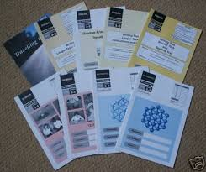
Key Stage 2 SATS
KS2 SATS week
Illness, emergencies, appointments
Papers
How we prepare your children
How to prepare your child
Results

Slide 3

KS2 SATS week 2026
Monday 11th May to Thursday 14th May
8:30am in school
Snack and juice
Tests take place in the morning
Rest of week ‘lighter’ activities
Children must sit tests in order so …
… it is essential every child is in every day
However …

Slide 4
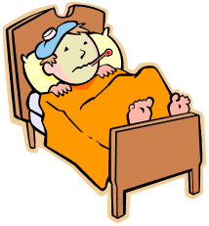
What if ill, emergency, appointments etc
Must inform us straight away!
Please phone the office
We can make alternative arrangements e.g.
  Sit paper and go home
  Sit paper at home
  Sit later on in day
  Sit following day
BUT, they must have no contact (face-to-face or online) with peers until they have caught up!

Slide 5
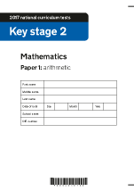
Papers
Monday - Grammar, Punctuation and Spelling
  Paper 1: Short questions (45 mins)
  Paper 2: Spelling test (20 words)
Tuesday – Reading (1 hour)
Wednesday – Maths
  Paper 1: Arithmetic (30 mins)
  Paper 2: Reasoning (40 mins)
Thursday – Maths
  Paper 3: Reasoning (40 mins)
Writing is assessed throughout the year
Please look but don’t take home – we use these for practising during the year!

Slide 6

How we prepare your children
Throughout the year!
Children had a ‘mock’ week in March
Children sit in small groups – most sit in their classroom
Other ‘lighter’ activities during the week
Singing
Drink and snack

Slide 7

How to prepare your child
Quiet Sunday beforehand – no sun burn!
Good night’s sleep every night
Try to avoid upsets/arguments
Eat a good breakfast
Don’t talk about SATS!
Get in on time – 8:30am

Slide 8

Results
Sent home in July
Test results – ‘Standardised Score’ (80 to 120)
  Less than 100 - Working towards ‘Expected standard’
  100 to 109 - Working at ‘Expected standard’
  110 to 120 - Working at ‘High’ standard
Teacher Assessments
  Working towards ‘Expected standard’
  Working at ‘Expected standard’
  Working at greater depth within ‘Expected standard’

